Slide 1

21PHY113
Computational Engineering Mechanics-II
UNDER THE GUIDANCE OF:
Mr. R. Pramod

Slide 2
Project title: Hydraulic gas lift bed mechanism

Slide 3
Batch: E4 Team members: M RAMYA SREE (BL.EN.U4AIE21072) METTU SIDDHARTHA (BL.EN.U4AIE21080) POLI VAMSI VARDHAN REDDY (BL.EN.U4AIE21101)

Slide 4
CONTENTS:
Introduction
Problem Statement
Design & 3D Modeling
Position Synthesis
Velocity Analysis
Acceleration Analysis
MSC Adams simulation
Demonstration of working model
Conclusions
Scope for future work
References

Slide 5
Introduction
Hydraulic Bed With the increase in the population and downsizing, people preferring to live in small apartments where space is at a minimum.
As a result, the storage space has become limited which is forcing home owners to find some creative ways to store linens and other assets.
If you are among those who want to give an organized look to the home, include hydraulic storage bed in the bedrooms.
They are the kind of bed which have built-in storage underneath the mattress area and can be easily accessible by the gas lift mechanism.
Hydraulic bed are designed to provide a concealed space without taking the valuable area and are attractive and practical.

Slide 6
Problem Statement
Difficult to move: Because they are bulky and crafted using hardwood so are hard to move from one room to another.
Cost: They are expensive as compared to regular beds. So, if someone is low on budget, then buying hydraulic storage is not a good option.
Problem with hardware: Sometimes their lift mechanism gets affected or the knobs, handles, hinges and track rollers eventually fall off or stop working after some years of use.

Slide 7
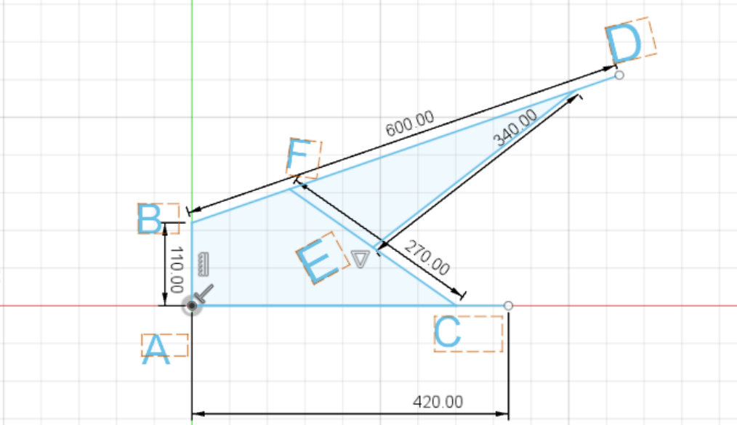
Design & 3D Modeling

Slide 8
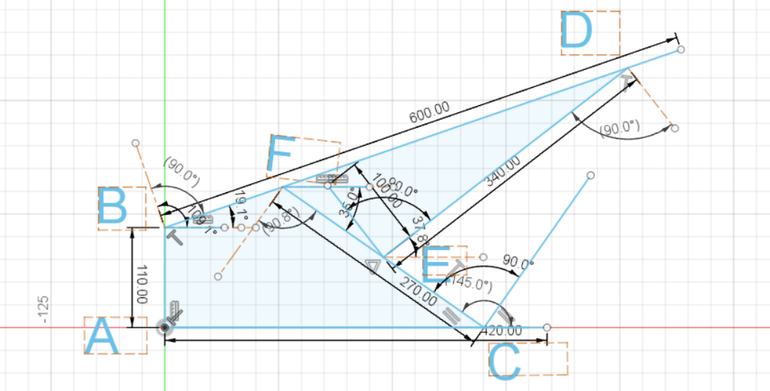
Position Synthesis

Slide 9
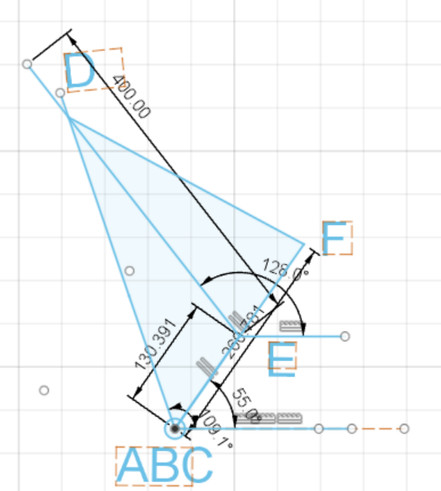
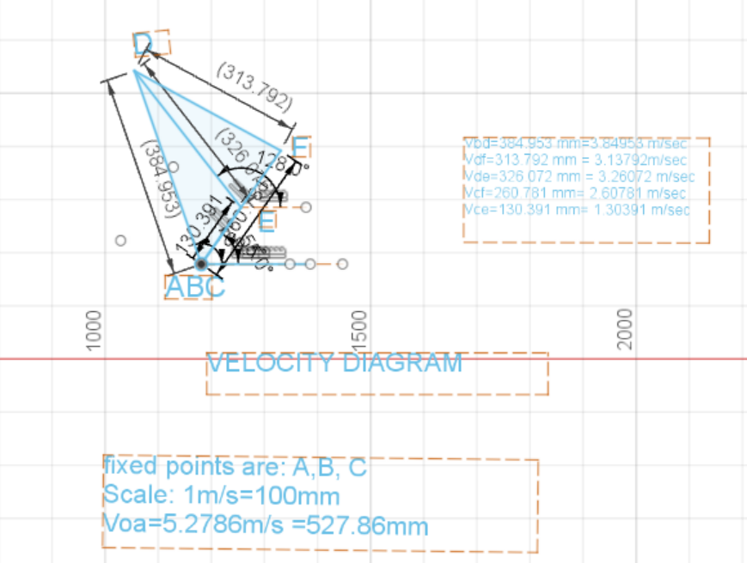
Velocity Analysis

Slide 10
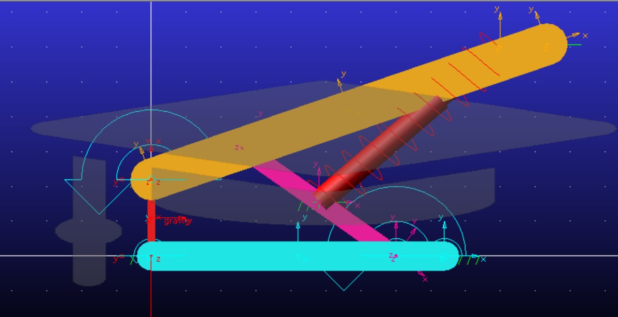
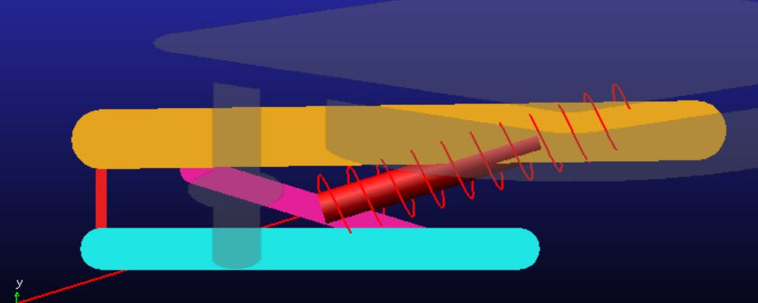
MSC Adams simulation

Slide 11
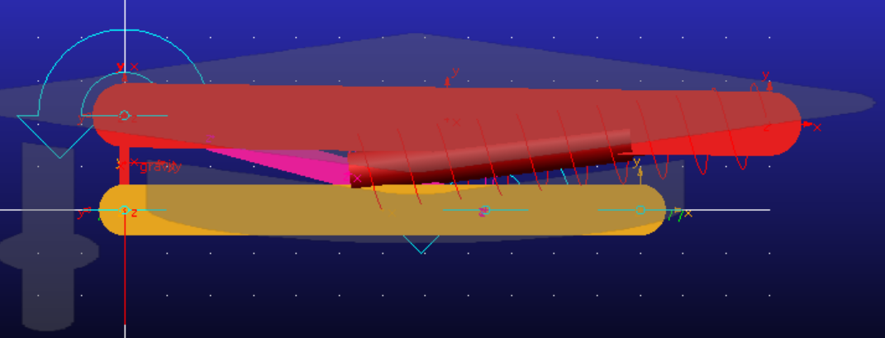
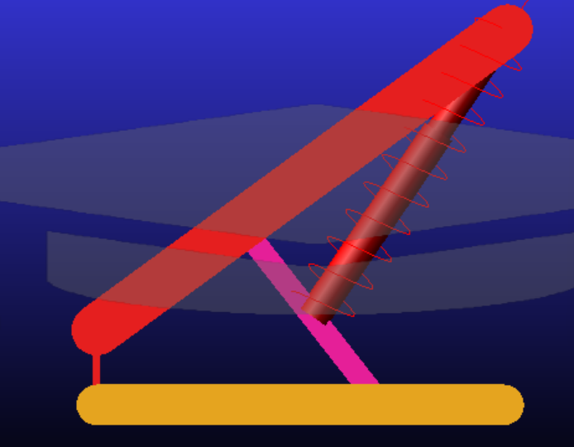

Slide 12
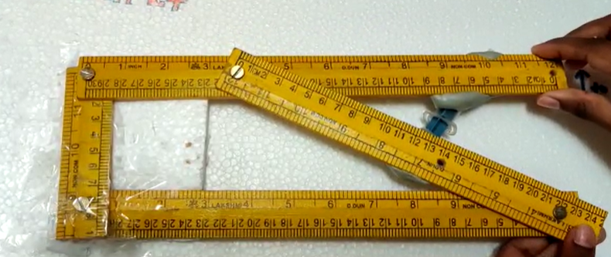
Demonstration of working model

Slide 13
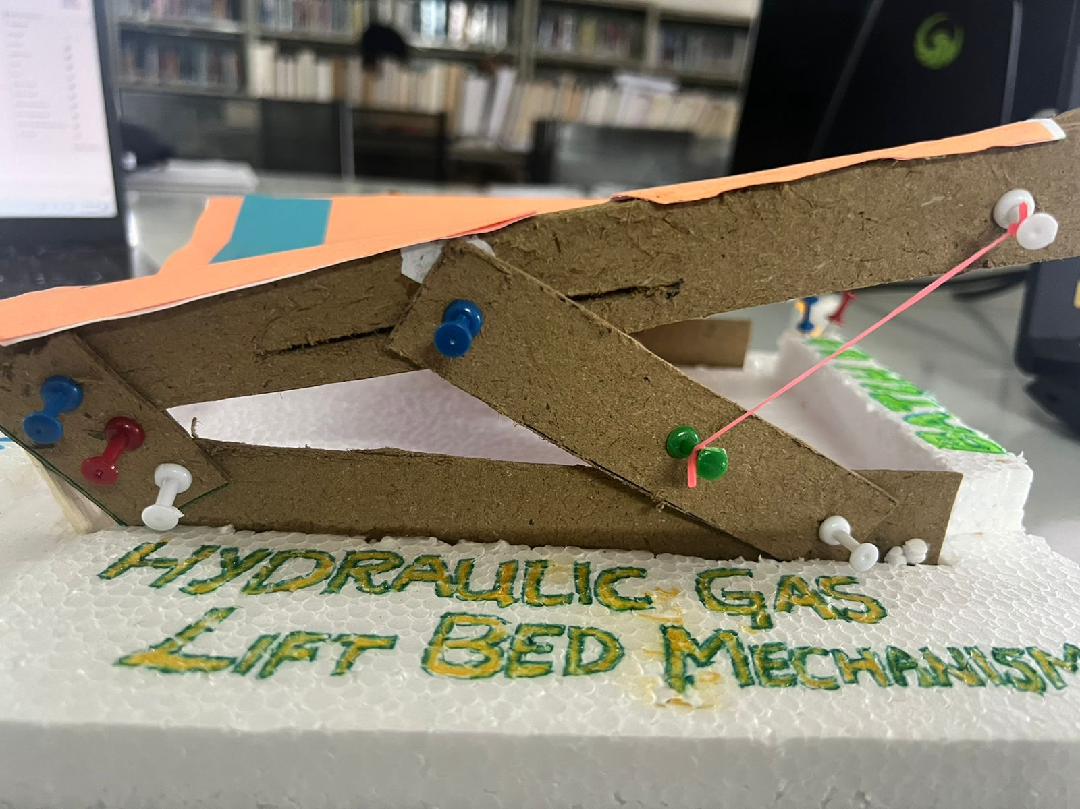

Slide 14
Conclusions
People are often finding difficulty in finding the storage space in the rooms, they often neglect the space underneath the bed.
With hydraulic beds, you can efficiently utilize the area underneath the bed as a storage unit.
Hydraulic beds free up floor space and help make a room more clutter-free.
Hydraulic beds are designed in a way that they provide a secret place to hide useful items.
They are used each day briefly, so the lifting mechanism lasts for quite a long time.

Slide 15
Scope for future work
This helps to keep the storage under the bed.
with use of bed sensor gear, we can automate the bed's opening and shutting procedures.
So it creates more space in the room.
To creates the hidden storage.

Slide 16
THANK YOU

